Slide 1



ST JOSEPH MERCY HOSPITAL
MIS 6940 CAPSTONE PROJECT
Final Project Presentation
Guided By:
Dr. Venu Gopal Balijepally
Dr. Anupam Sule
Priyanka Sabnani

Slide 2
St Joseph Mercy Hospital
Foundation: In 1911, four Sisters of Mercy arrived in Ann Arbor from Dubuque, Iowa. They came at the invitation of local medical and religious leaders who dreamed of founding a community hospital to serve area residents. That dream became a reality on November 21, 1911, when the Sisters opened St. Joseph's Sanatorium, a small hospital located in a former student rooming house at the corner of State and Kingsley streets.
Saint Joseph Mercy Health System (SJMHS) is one of the largest health care networks based in southeast Michigan, United States.
It consist of five prime hospitals, nine Urgent Care Centres, and five Health Centres spread around metro Detroit, providing health care in six counties that include Livingston, Macomb, Oakland, St. Clair, Washtenaw, and Wayne

Slide 3
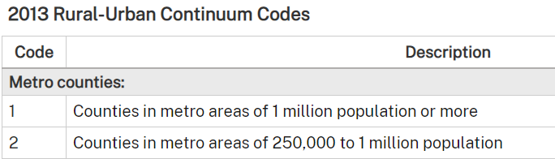

Objective of the RESEARCH
To understand if reduction in the daily mobility of people in US semi-urban counties 1 and 4 (based on the US Urban-Rural continuum codes) is associated with any reduction in the spread of COVID-19 during the pandemic’s initial spread (i.e., early 2020) and its later resurgence (Oct – Dec 2020)
What is the virus situation in all parts of United States of America?
A detailed county wise comparison of all counties (total county type is 4)
Probable reasons: government norms/ demographics of a county that play a role in the spread of the virus.
Impact of regulation imposed to control the spread.

Slide 4
SPONSORS FOR THE PROJECT
Dr Venugopal Balijepally
The University of Texas at Arlington (Ph.D.)
Management Development Institute, India (MBA)
Indian Institute of Technology IIT, Mumbai (M.S)
Dr. Anupam Sule
M.D of Information and Outcomes at St. Joseph’s Hospital
Oakland University William Beaumont School of Medicine

Slide 5
Demographic Variable list
Household Composition & Disability |  | Minority Status & Language
Aged 65 or Older EP_AGE65 |  | Minority EP_MINRTY
Aged 17 or Younger EP_AGE17 |  | Speaks English “Less than Well” EP_LIMENG
Civilian with a Disability EP_DISABL
Single-Parent Households EP_SNGPNT |  | Housing Type & Transportation
 |  | Multi-Unit Structures EP_MUNT
Socioeconomic Status |  | Mobile Homes EP_MOBILE
Below Poverty EP-POV |  | Crowding EP_CROWD
Unemployed EP_UNEMP |  | No Vehicle EP_NOVEH
Income EP_PCI |  | Group Quarters EP_GROUPQ
No High School Diploma EP_NOHSDP
 |  | Socioeconomic - RPL_THEME1
 |  | Household Composition & Disability - RPL_THEME2
 |  | Minority Status & Language - RPL_THEME3
 |  | Housing Type & Transportation - RPL_THEME4
 |  | Overall RPL_THEMES

Slide 6
DEFINING VARIABLES FOR THE RESEARCH
Definition start and end of wave
Start of pandemic- Cumulative cases above 10 per 100K
Start of “Wave”1-The 7 day moving average is more than 14 day moving average which is more than 28 day moving average for more than 7days and Pandemic has started
End of “Wave”1 -The 7 day moving average is less than 14 day moving average which is less than 28 day moving average for more than 7 days and Pandemic has started
Start of “Wave”2-The 7 day moving average is more than 14 day moving average which is more than 28 day moving average for more than 7 days and less than End of Wave1 and Pandemic started
End of “Wave”2 -The 7 day moving average is less than 14 day moving average which is less than 28 day moving average for more than 7 days and less than Stat of Wave2 and Pandemic started
PHASE 2

Slide 7
DEFINING VARIABLES FOR THE RESEARCH
MOP Magnitude of pandemic- Cumulative cases per 100,000 population at day 120 after crossing threshold point of start of pandemic.
01
SOP Severity of pandemic – Mortality per 100 covid cases at day 120 after crossing threshold point of start of pandemic
02
MOW Magnitude of wave- Cumulative cases per 100,000 population at day 15, 30, 60, 120 after crossing threshold point of start of wave.
03
SOW Severity of wave – Mortality per 100 covid cases at day 120 after crossing threshold point of start of wave
04

Slide 8
VARIABLES FROM UNCAST DATA Methodology for US Social Distancing Scoreboard
Metric 1: Difference (in %) in distance travelled
Definition: Percent reduction in total distance travelled per device, averaged across all devices located in the county.
• Reflects the difference in distance travelled per identifier, averaged on the county level
o The metric is calculated each day as a percentage difference vs the avg distance travelled in the same county on the same weekday during the 4 weeks pre-Corona
PHASE 3

Slide 9
VARIABLES FROM UNCAST Methodology for US Social Distancing Scoreboard
Metric 2: Difference (in %) in visitation of non-essential POIs
Definition: Difference in visitation of non-essential POIs on a specific POST-COVID19 day compared to a corresponding PRE-COVID19 baseline.
• Non-essential POIs combine (1) venues from the VDP output and (2) additional BYOPOI based on categories from OpenSteetMaps (added to get more data → increase the accuracy of the metric) and they belong to the following groups :
o Retail and Services: Restaurant (multiple kinds), Department Store, Clothing (multiple kinds), Footwear, Discount Stores, Jewellery, Computers + Consumer Electronics, Gifts, Seasonal, Books, Office Supplies, Hair, Cosmetics + Beauty Supplies, Gyms + Fitness Facilities, Communications, New/Used Car Dealers, Hotels, Used Products, "Crafts, Toys, and Hobbies", Travel, "Spa, Massage, + Aesthetics", Sports + Recreation, Weight Loss, Furnishings, Home +
Housewares, Home Improvement +Building Supplies, "Printing, Copying + Publishing", Theatres, Music, Amusement, Furnishing Rentals, Shared Offices + Coworking, Car Wash, Cannabis Retail, Flowers
o OpenSteetMaps POIs:
Unacast, Inc. US Social Distancing Scoreboard Methodology (2020)
▪ amenity: bar, pub, cafe, restaurant, theatre, nightclub, cinema, casino ▪ leisure: bowling_alley, fitness_centre, cafe, restaurant, theatre,
nightclub
▪ shop: department_store, mall, clothes, shoes, doityourself, furniture, sports

Slide 10
VARIABLES FROM UNCAST Methodology for US Social Distancing Scoreboard
Metric 3: Rate of Human Encounters compared to National Average pre Corona
Definition: Estimate of close encounters between two devices per square km, expressed as a fraction of pre-Corona baseline.
M3 = (( #unique encounters per day / km^2 ) / baseline ) – 1
▪ Encounter
o Defined as two clusters observed in spatial distance, ∆d, of 50 m or less and in temporal distance, ∆t, of 60 min or less. The metric was inspired by the one used by Pepe et al.("To create such a network, we assert proximity between any two users of the same province who were seen within a circle of radius R = 50m over a 1 hour period." Pepe et al.).
▪ Cut-offs for the grades
o Defined based on the average x͂ from the distribution of the metric in PRE COVID19 period and fixed percentages of this value; the baseline value represents "business as usual" and based on how much the number of
encounters decreases

Slide 11
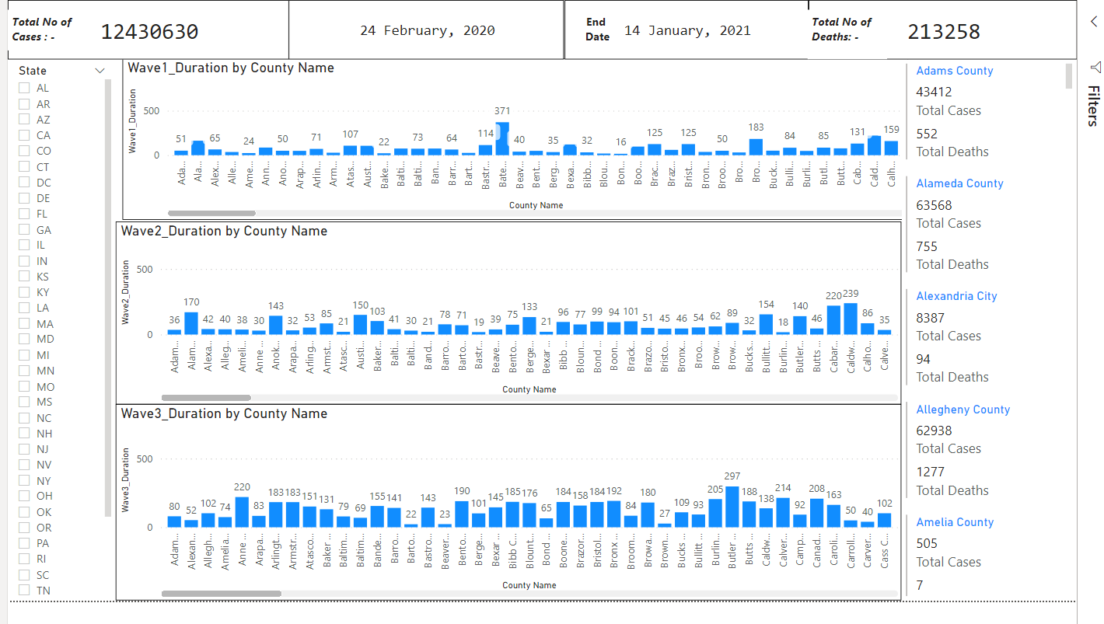
DASHBOARD ANALYSIS

Slide 12
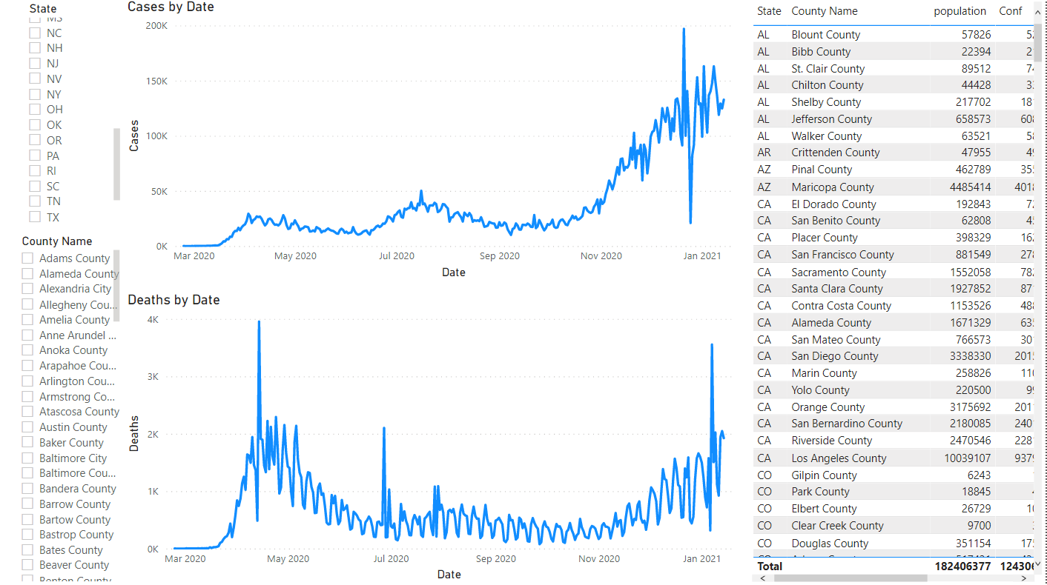
Trends of cases vs trends of deaths

Slide 13
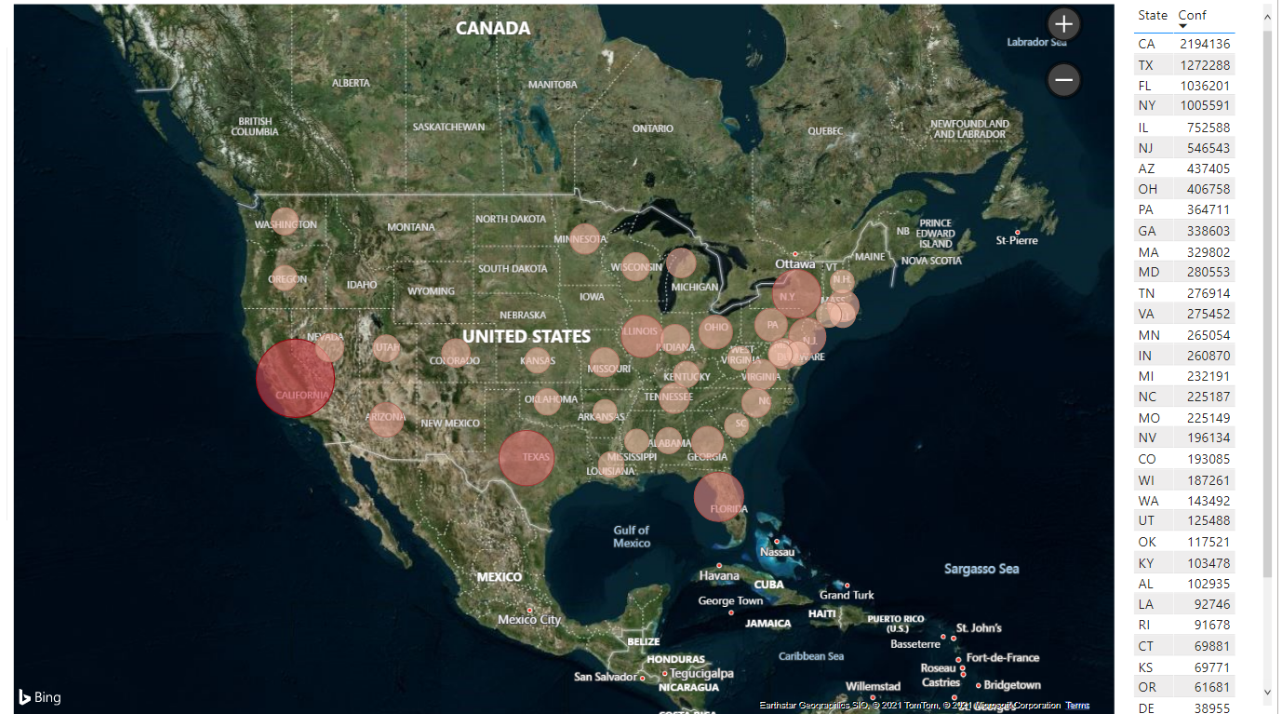
GEO CASES

Slide 14
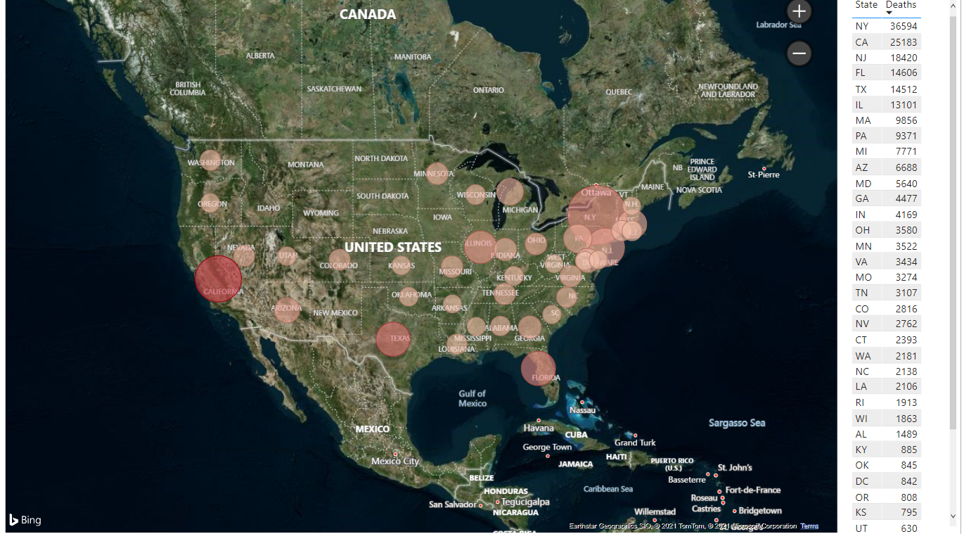
GEO DEATHS

Slide 15
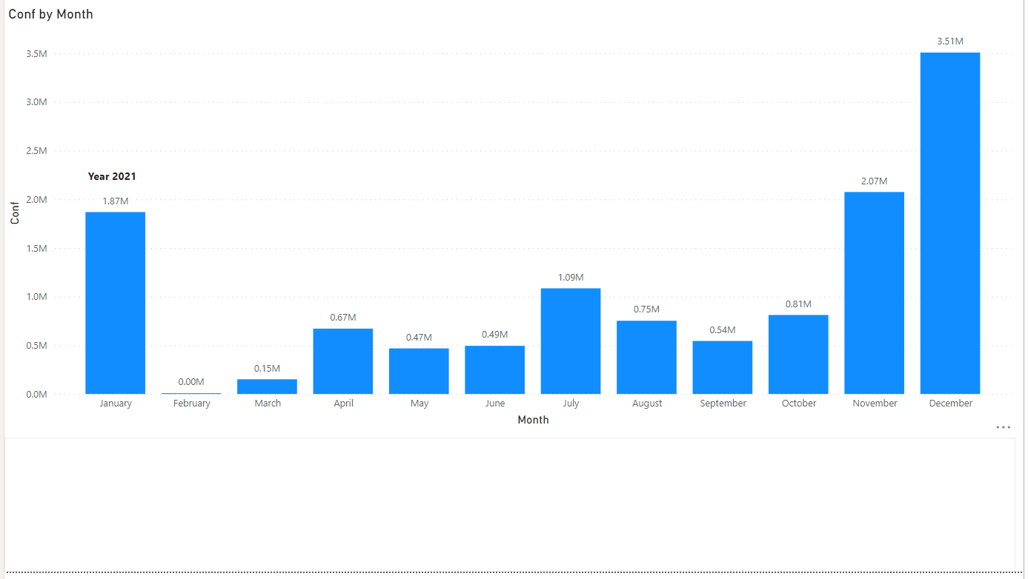
OVERALL CASES SPREAD TREND

Slide 16
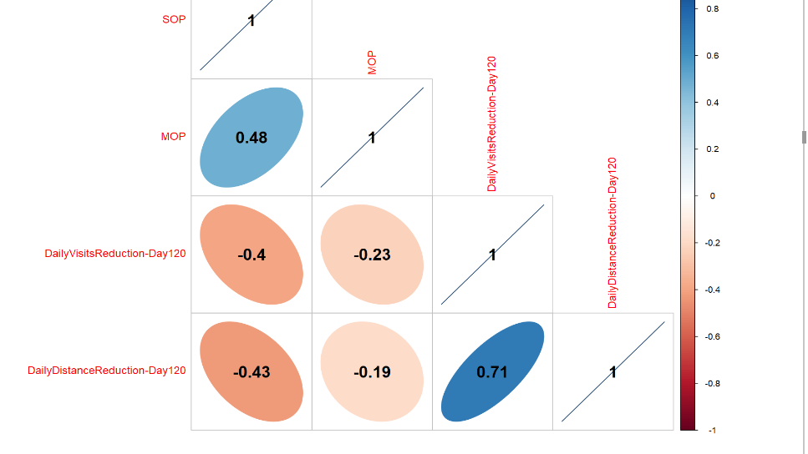
Correlation Matrix

Slide 17
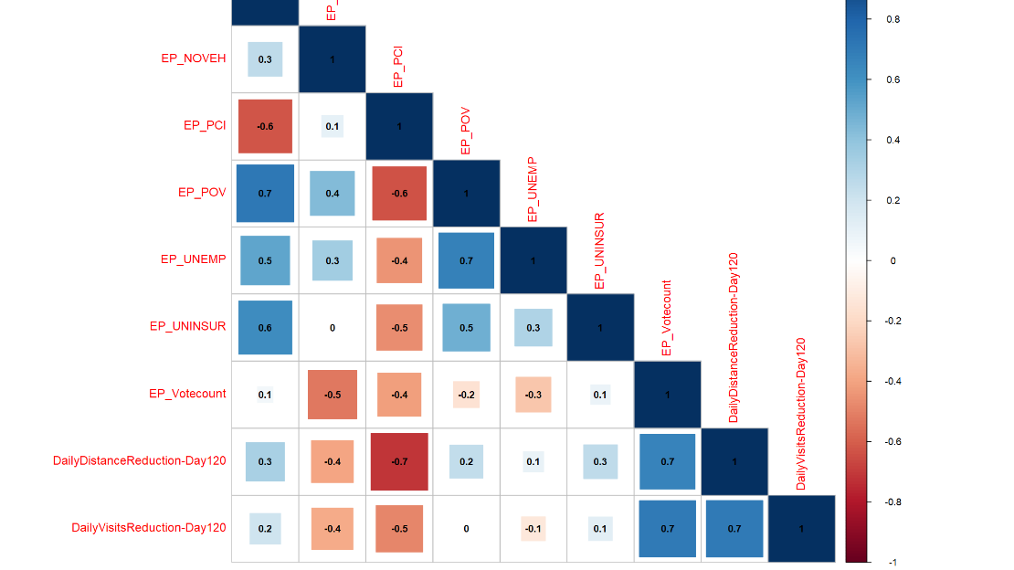
Correlation- Metrics and Demographic variables

Slide 18
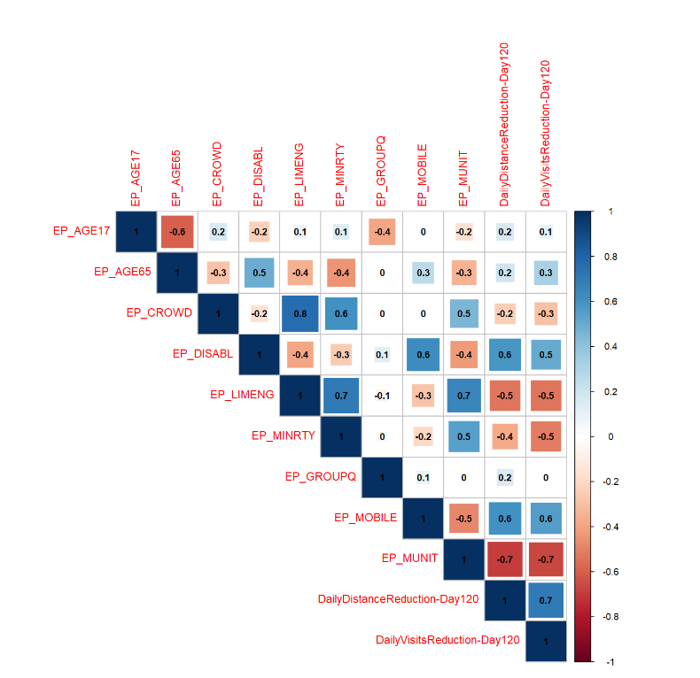
CORRELATION-Metrics and demographic variables

Slide 19
SOLUTION EVALUATION
Meaningful Insights on corona count state wise and county wise
Impact of government guidelines to control the virus spread
Various Trends can be figured like trends of different magnitude of waves and severity of waves etc..
Can help government and health care system to better understand the volatility of the virus
Restrictions and Lockdowns are proven measures to control the virus
Control on Inbound International flights can also be a measure to control the spread of the virus

Slide 20
Lessons Learned
Defining Variables and logic needs time and expertise
The agile format of working with every week changes and findings
Always try different ways to do the same thing to check credibility of the output
The hit and trial needs patience and lot of attention
Sometimes it is very important to step out and look at the problem from a holistic approach

Slide 21
LIMITATIONS
Excel is not a very powerful tool for handling data with millions of rows
Defining logic and designing algorithm is a difficult task and the most important one
The republican vote count data was not updated, we chose 2018

Slide 22
FUTURE WORK
Revised research based on data collected after January 2021
Impact of demography on spread of corona virus cases
A logistic Regression model can be built for SOP (Severity of Pandemic) high or low of a given county based on other variables

Slide 23
Major sources for data collection
https://covid19.census.gov/
https://www.neighborhoodatlas.medicine.wisc.edu/
https://atlasdata.dartmouth.edu/downloads
Other sheets and materials provided by Mentors.

